Slide 1
Hash Tables
Lecture # 11

Slide 2
Introduction
When discussing search we saw:
linear search – O( n )
binary search – O( log n )
Can we improve the search operation to achieve better than O( log n ) time?

Slide 3
Comparison-Based Searches
To locate an item, the target search key has to be compared against the other keys in the collection.
O( log n) is the best that can be achieved.
We must use a different technique if we want to improve the search time.

Slide 4
Hashing
The process of mapping a search key to a limited range of array indices.
The goal is to provide direct access to the keys.
hash table – the array containing the keys.
hash function – maps a key to an array index.

Slide 5
Hashing Example
Suppose we have a list of popular fruits, we want to find if a particular type of fruit is in our inventory.
Apple, Banana, Grape, Orange, Pear, Pineapple, Strawberry.
We could use an array of 26 elements, each is index by the first letter of the fruit name, assuming no repetition. We can simply check for fruit[name[0]]!

Slide 6
Hashing Example
Suppose we have the following set of keys
a hash table, T, with M = 13 elements.
We can define a simple hash function h()
h(765) -> 11, h(431) -> 2, …
765, 431, 96, 142, 579, 226, 903, 388
h(key) = key % M

Slide 7
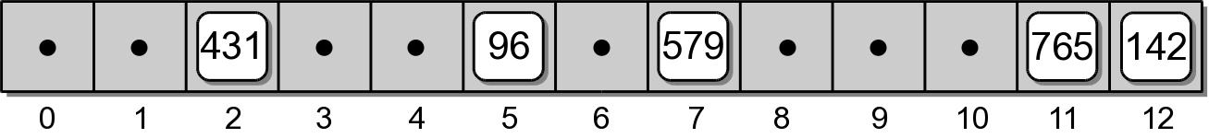
Adding Keys
To add a key to the hash table:
Apply the hash function to determine the array index in which the key should be stored.
h(765) => 11
h(431) => 2
h(96) => 5
h(142) => 12
h(579) => 7
Store the key in the given slot.

Slide 8
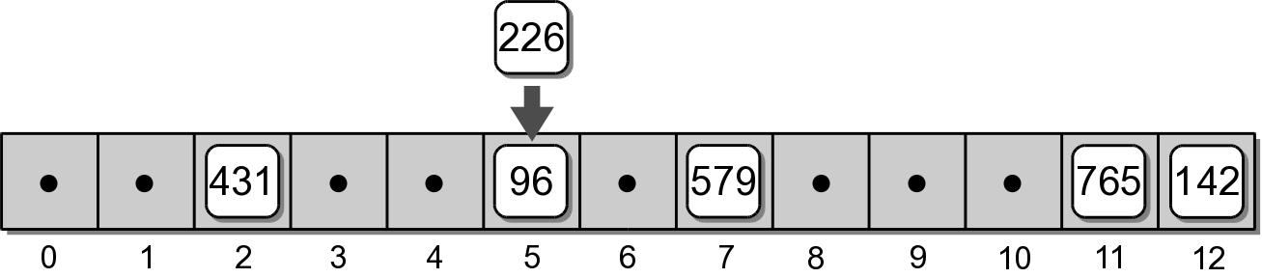
Collisions
What happens when we attempt to add key 226?
h(226) => 5
collision – when two or more keys map to the same hash location.

Slide 9
Resolving collisions
There are in general two approaches to resolve collisions,
Closed hashing: find a spot within the hash table to store the new element
Open hashing: create a structure, e.g., a list, or a tree, in the hashed spot to store the elements that have the same hashing key
We first concentrate on closed hashing.

Slide 10
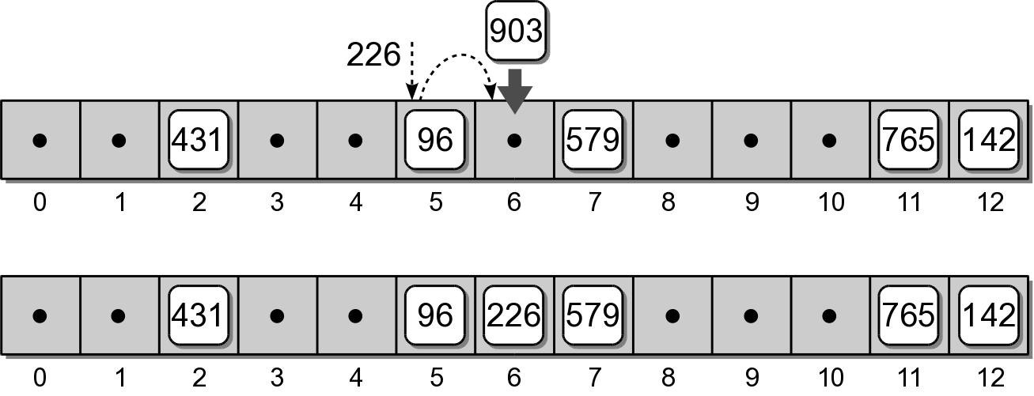
Closed hashing: probing
If two keys map to the same table entry, we must resolve the collision to find another available slot.
linear probe – simplest approach which examines the table entries in sequential order.

Slide 11
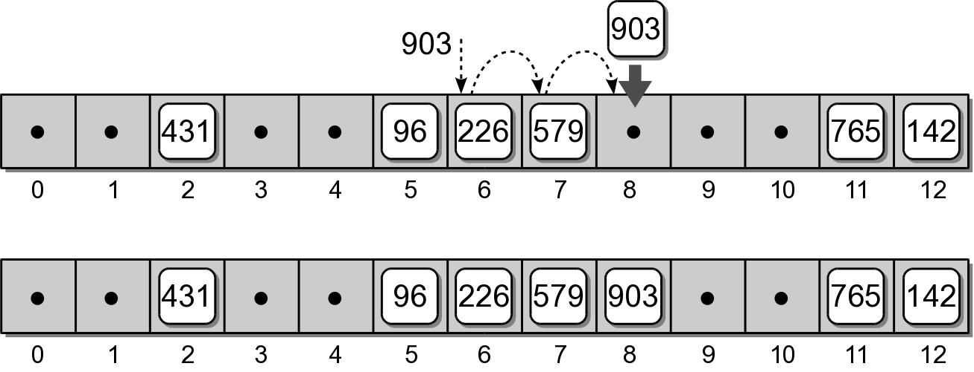
Probing
Consider adding key 903 to our hash table.
h(903) => 6

Slide 12
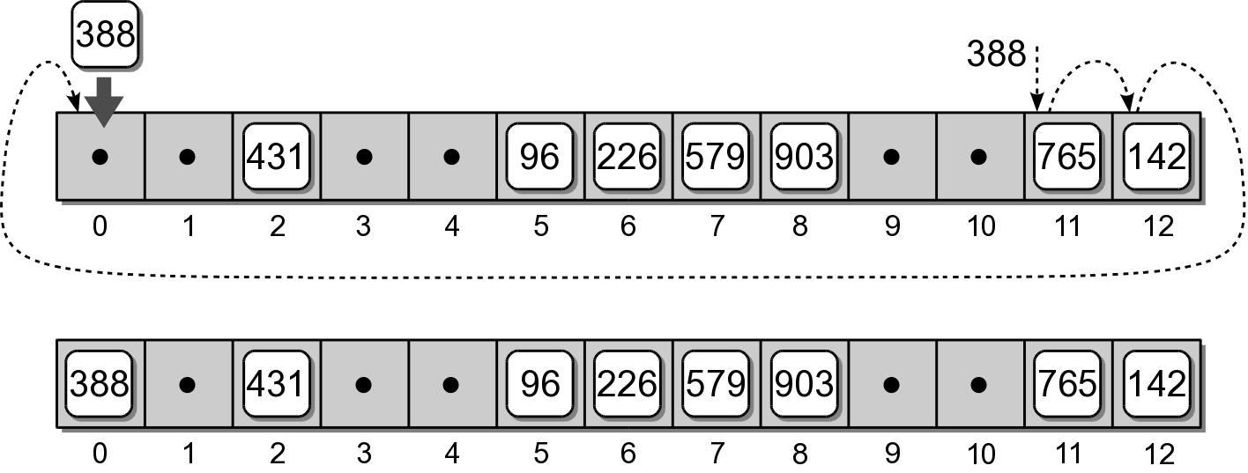
Probing
If the end of the array is reached during the probe, it wraps around to the first entry and continues.
Consider adding key 388 to our hash table.
h(388) => 11

Slide 13
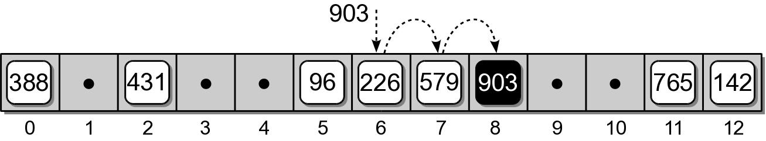
Searching
Searching a hash table for a specific key is very similar to the add operation.
Target key is mapped to an initial slot.
See if the slot contains the target.
Otherwise, apply the same probe used to add keys to locate the target.
Example: search for key 903.

Slide 14
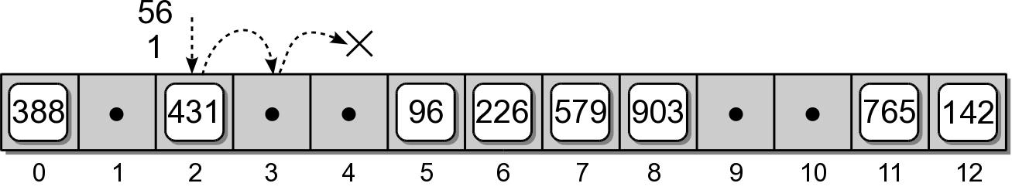
Searching
What if the key is not in the hash table?
The probe continues until either:
a null reference is reached, or
all slots have been examined.

Slide 15
Deleting Keys
Deleting a key from a hash table is a bit more complicated than adding keys.
We can search for the key to be deleted.
But we cannot simply remove it by setting the entry to None.

Slide 16
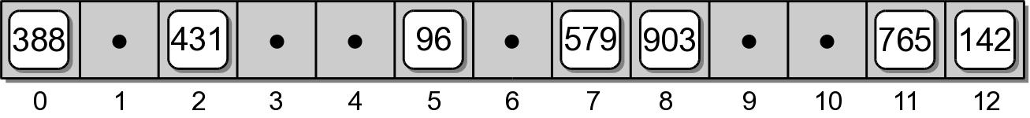
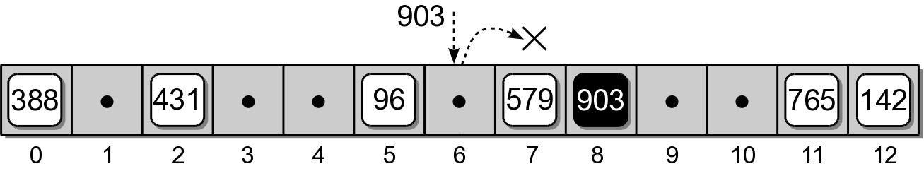
Incorrect Deletion
Suppose we simply remove key 226 from slot 6.
What happens if we search for key 903?

Slide 17
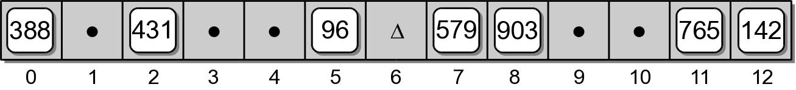
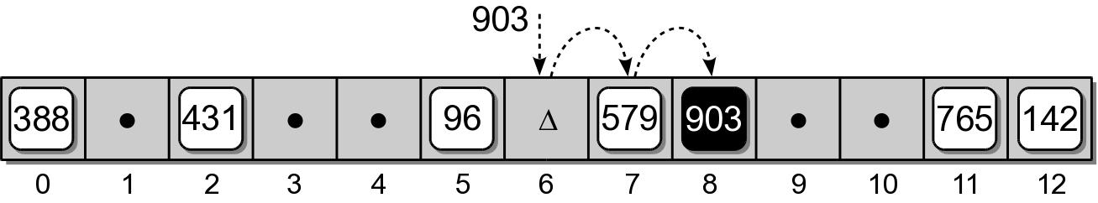
Correct Deletion
We use a special flag to indicate the entry is now empty, but was previously occupied.
When searching a hash table, the probe must continue past the slot(s) with the special flag.

Slide 18
Clustering
The grouping of keys in a common area.
As more keys are added to the hash table, more collisions are likely to occur.
Clusters begin to form due to the probing required to find an empty slot.
As a cluster grows larger, more collisions will occur.
primary clustering – clustering around the original hash position.

Slide 19
Probe Sequence
The order in which the hash entries are visited during a probe.
The linear probe steps through the entries in sequential order.
The next array slot can be represented as
where
i is the i^{th} probe.
home is the home position
slot = (home + i) % M

Slide 20
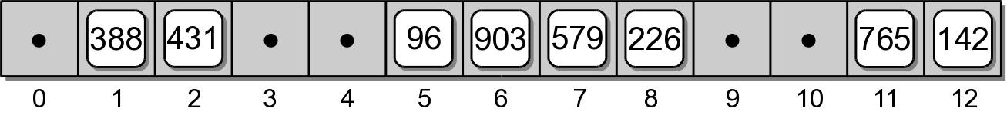
Modified Linear Probe
We can improve the linear probe by changing the step size to some fixed constant.
Suppose we set c = 3 to build the hash table.
slot = (home + i * c) % M
h(765) => 11 h(579) => 7
h(431) => 2 h(226) => 5 => 8
h(96) => 5 h(903) => 6
h(142) => 12 h(388) => 11 => 1

Slide 21
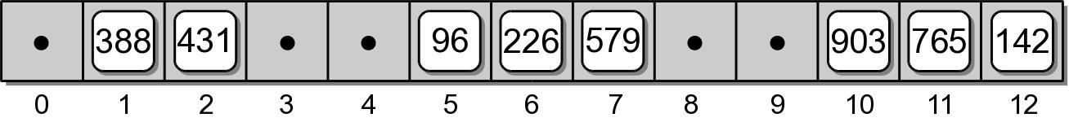
Quadratic Probing
A better approach for reducing primary clustering.
Increases the distance between each probe in the sequence.
Example:
slot = (home + i**2) % M
h(765) => 11 h(579) => 7
h(431) => 2 h(226) => 5 => 6
h(96) => 5 h(903) => 6 => 7 => 10
h(142) => 12 h(388) => 11 => 12 => 2 => 7 => 1

Slide 22
Computations from last slide
Quadratic probing
h(765) => 11 h(579) => 7
h(431) => 2 h(226) => 5 => 6
h(96) => 5 h(903) => 6 => 7 => 10
h(142) => 12 h(388) => 11 => 12 => 2 => 7 => 1
h(226) => 5, second (5 + 1²) % M => 6
h(903) => 6, second (6 + 1²) % M => 7, third (6 + 2²) % M => 10
h(388) => 11, second (11 + 1²) % M => 12,
third (11 + 2²) % M => 2, fourth(11 + 3²) % M => 7,
fifth (11 + 4²) % M => 1

Slide 23
Quadratic Probing
Reduces the number of collisions.
Introduces the problem of secondary clustering.
When two keys map to the same entry and have the same probe sequence.
Example: add key 648
hashes to entry 11
follows the same sequence as key 388

Slide 24
Double Hashing
When a collision occurs, a second hash function is used to build a probe sequence.
Step size remains a constant throughout the probe.
Multiple keys that have the same home position, will have different probe sequences.
slot = (home + i * hp(key)) % M

Slide 25
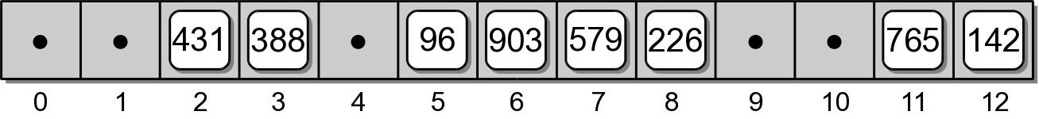
Double Hashing
A simple choice for the second hash function.
Example: let P = 8
hp(key) = 1 + key % P
h(765) => 11 h(579) => 7
h(431) => 2 h(226) => 5 => 8
h(96) => 5 h(903) => 6
h(142) => 12 h(388) => 11 => 3

Slide 26
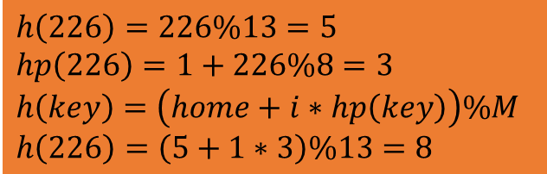
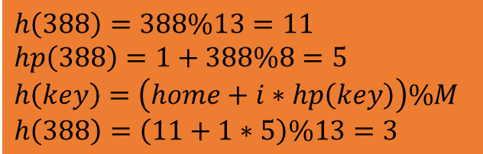
Computations from last slide
$$h\left(226\right)=226\%13=5$$
$$hp\left(226\right)=1+226\%8=3$$
$$h\left(key\right)=\left(home+i∗hp\left(key\right)\right)\%M$$
$$h\left(226\right)=\left(5+1∗3\right)\%13=8$$
Double hashing
slot = (home + i * hp(key)) % M, e.g., M==13
hp(key) = 1 + key % P, e.g., P == 8
h(765) => 11 h(579) => 7
h(431) => 2 h(226) => 5 => 8
h(96) => 5 h(903) => 6
h(142) => 12 h(388) => 11 => 3
$$h\left(388\right)=388\%13=11$$
$$hp\left(388\right)=1+388\%8=5$$
$$h\left(key\right)=\left(home+i∗hp\left(key\right)\right)\%M$$
$$h\left(388\right)=\left(11+1∗5\right)\%13=3$$
h(226) => 5, double hashing [(5+(1*(1+226%P)))] % M => 8
h(388) => 11, double hashing [(11+(1*(1+388%P)))] % M => 3

Slide 27
Table Size
How big should a hash table be?
If we know the max number of keys.
create it big enough to hold all of the keys.
In most instances, we don't know the number of keys.
Most probing techniques work best when the table size is a prime number (e.g.,11,13,17,19,…).

Slide 28
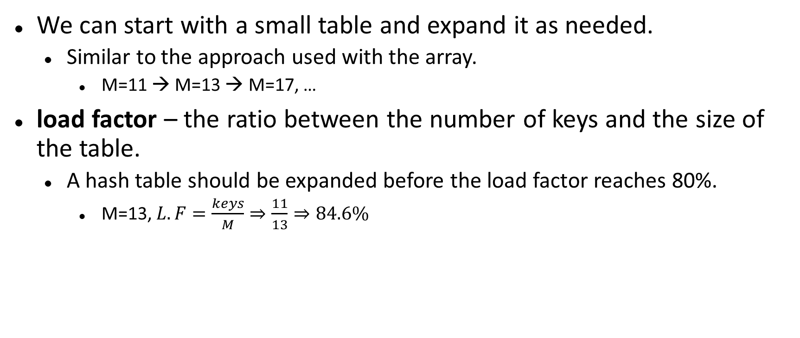
Rehashing
We can start with a small table and expand it as needed.
Similar to the approach used with the array.
M=11 → M=13 → M=17, …
load factor – the ratio between the number of keys and the size of the table.
A hash table should be expanded before the load factor reaches 80%.
M=13, $L.F=\frac{keys}{M}⇒\frac{11}{13}⇒84.6\%$

Slide 29
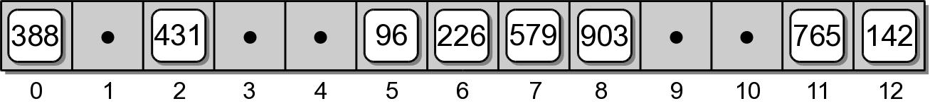
Rehashing Example
After creating a larger array for the table, we can not simply copy the original keys to the new table.
We must rebuild or rehash the entire table.
h(765) => 0 h(579) => 1
h(431) => 6 h(226) => 5
h(96) => 11 h(903) => 2
h(142) => 6 => 7 h(388) => 14

Slide 30
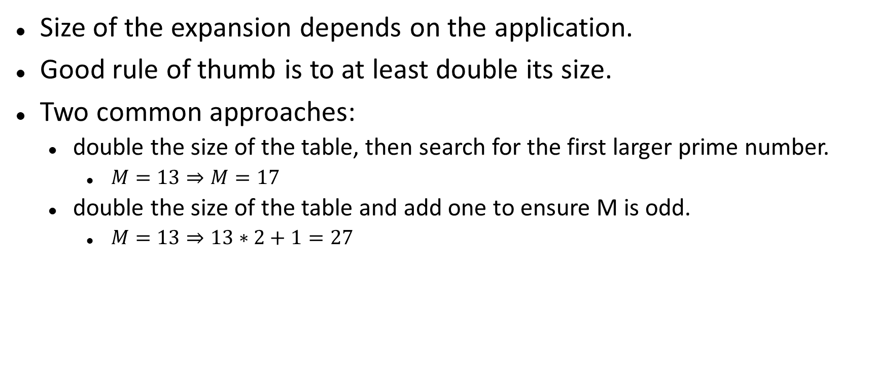
Expansion Size
Size of the expansion depends on the application.
Good rule of thumb is to at least double its size.
Two common approaches:
double the size of the table, then search for the first larger prime number.
$M=13⇒M=17$
double the size of the table and add one to ensure M is odd.
$M=13⇒13∗2+1=27$

Slide 31
Efficiency Analysis
Depends on:
the hash function
size of the table
type of collision resolution probe
Once an empty slot is located, adding or deleting a key can be done in O(1) time.
The time required to perform the search is the main contributor to the overall time of all ops.

Slide 32
Efficiency Analysis
Best case: O(1)
The key maps directly to the correct entry.
There are no collisions.
Worst case: O(m)
Assume there are n keys stored in a table of size m.
The probe has to visit every entry in the table.

Slide 33

Efficiency Analysis
While hashing appears to be no better than a basic linear search or binary search in worst case, hashing is very efficient in the average case with load factor < 0.8. (Table shows the data for M == 13.)
Remember linear search O(n), binary search O($\log{n}$) and $\log_{2}{13}$ s about 3.7.
Load Factor | 0.25 | 0.5 | 0.67 | 0.8 | 0.99
Successful search:
Linear probe | 1.17 | 1.50 | 2.02 | 3.00 | 50.50
Quadratic probe | 1.66 | 2.00 | 2.39 | 2.90 | 6.71
Unsuccessful search:
Linear probe | 1.39 | 2.50 | 5.09 | 13.00 | 5000.50
Quadratic probe | 1.33 | 2.00 | 3.03 | 5.00 | 100.00

Slide 34
Hash Functions
The efficiency of hashing depends in large part on the selection of a good hash function.
A “perfect” function will map every key to a different table entry.
This is seldom achieved except in special cases.
A “good” hash function distributes the keys evenly across the range of table entries.

Slide 35
Function Guidelines
Important guidelines to consider in designing a hash function.
Computation should be simple.
Resulting index can not be random.
Every part of a multi-part key should contribute.
Table size should be a prime number.

Slide 36
Common Hash Functions
Division – simplest for integer values.
Truncation – some columns in the key are ignored.
Example: assume keys composed of 7 digits.
Use the 1st, 3rd, 6th digits to form an index (M = 1000).
Using this technique, key value 4873152 would hash to index 832.
h(key) = key % M

Slide 37
Common Hash Functions
Folding – key is split into multiple parts then combined into a single value.
Given the key value 4873152, split it into three smaller values (48, 73, 152).
Add the values together and use with division to get the index location.

Slide 38
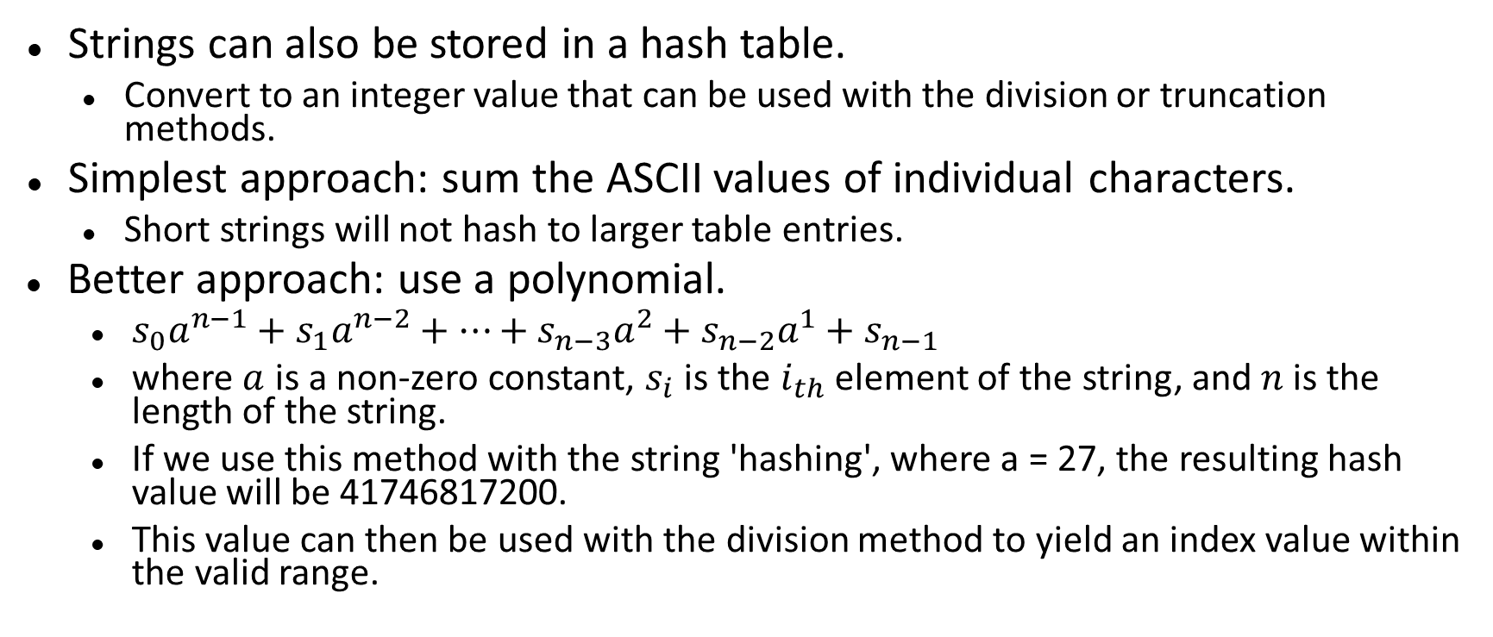
Hashing Strings
Strings can also be stored in a hash table.
Convert to an integer value that can be used with the division or truncation methods.
Simplest approach: sum the ASCII values of individual characters.
Short strings will not hash to larger table entries.
Better approach: use a polynomial.
$s_{0}a^{n−1}+s_{1}a^{n−2}+…+s_{n−3}a^{2}+s_{n−2}a^{1}+s_{n−1}$
where $a$ is a non-zero constant, $s_{i}$ is the $i_{th}$ element of the string, and $n$ is the length of the string.
If we use this method with the string 'hashing', where a = 27, the resulting hash value will be 41746817200.
This value can then be used with the division method to yield an index value within the valid range.

Slide 39
The Hash Map ADT
Hash tables are commonly used to implement a map or dictionary.
Same as the Map ADT.
Keys must be hashable.
Python's dictionary is implemented using a hash table.

Slide 40
HashMap Implementation
Hash table:
Initial size: M = 7
Must expand as needed.
Load factor: 2/3
Expansion size: 2M + 1
Entries:
class _MapEntry :
def __init__( self, key, value ):
self.key = key
self.value = value

Slide 41
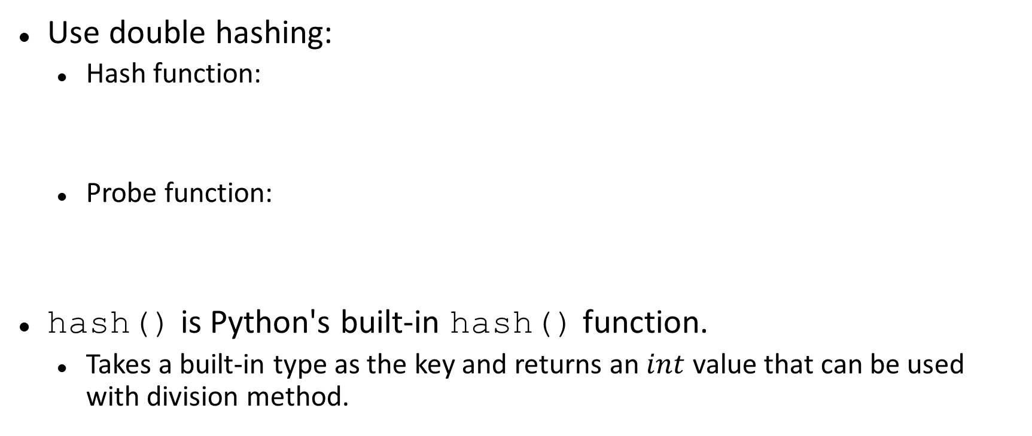
HashMap Implementation
Use double hashing:
Hash function:
Probe function:
hash() is Python's built-in hash() function.
Takes a built-in type as the key and returns an $int$ value that can be used with division method.
h(key) = |hash(key)| % M
hp(key) = 1 + |hash(key)| % (M - 2)

Slide 42
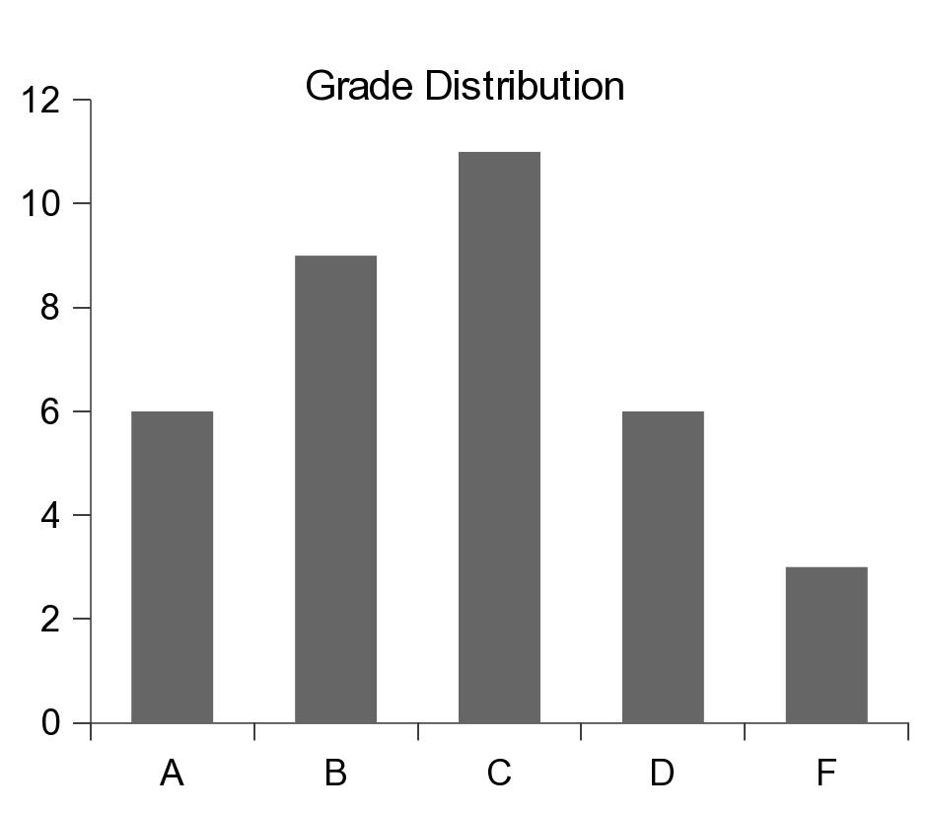
Application: Histograms
Graphical chart of tabulated frequencies.
Very common in statistics.
Used to show the distribution of data

Slide 43
The Histogram ADT
A histogram is a container that can be used to collect and store discrete frequency counts across multiple categories.
The category objects must be comparable.
Histogram( catSeq ) getCount( category ) incCount( category ) totalCount() iterator()

Slide 44
Building a Histogram
We can use the ADT to show a grade distribution.
Input: text file containing int grades
Output
77 89 53 95 68 86 91 89 60 70 80 77 73 73 93 85 83
67 75 71 94 64 79 97 59 69 61 80 73 70 82 86 70 45 100
Grade Distribution
|
A +******
|
B +*********
|
C +***********
|
D +******
|
F +***
|
+----+----+----+----+----+----+----+----
0 5 10 15 20 25 30 35

Slide 45
Histogram: Example
buildhist.py
from maphist import Histogram
def main():
# Create a Histogram instance for computing the frequencies.
gradeHist = Histogram( "ABCDF" )
# Open the text file containing the grades.
gradeFile = open('cs204grades.txt', "r")
# Extract the grades and increment the appropriate counter.
for line in gradeFile :
grade = int(line)
gradeHist.incCount( letterGrade(grade) )
# Print the histogram chart.
printChart( gradeHist )

Slide 46
Histogram: Example
buildhist.py
# Determines the letter grade for the given numeric value.
def letterGrade( grade ):
if grade >= 90 :
return 'A'
elif grade >= 80 :
return 'B'
elif grade >= 70 :
return 'C'
elif grade >= 60 :
return 'D'
else :
return 'F'

Slide 47
Histogram: Example
buildhist.py
def printChart( gradeHist ):
print( " Grade Distribution" )
# Print the body of the chart.
letterGrades = ( 'A', 'B', 'C', 'D', 'F' )
for letter in letterGrades :
print( " |" )
print( letter + " +", end = "" )
freq = gradeHist.getCount( letter )
print( '*' * freq )
# Print the x-axis.
print( " |" )
print( " +----+----+----+----+----+----+----+----" )
print( " 0 5 10 15 20 25 30 35" )
# Calls the main routine.
main()

Slide 48
The Color Histogram
Used to tabulate the frequency counts of individual colors within a digital image.
Example that deals with millions of distinct categories, none of which are known up front.
Used in image processing and digital photography.
The Histogram ADT would not be efficient for this application.

Slide 49
Color Histogram ADT
A color histogram is a container that can be used to collect and store frequency counts for multiple discrete RGB colors.
RGB values are discrete in the range [0 ... 255].
ColorHistogram() getCount( red, green, blue ) incCount( red, green, blue ) totalCount() iterator()

Slide 50
Color Histogram: Organization
What data structure should be used?
3-D array of size 256 x 256 x 256:
Very fast with direct access.
Far too costly in terms of memory.
Vector or linked list:
Better in terms of memory.
Inefficient when working with millions of colors.

Slide 51
Color Histogram: Organization
What about hashing?
Closed hashing:
Inefficient due to the many rehashes that would be required.
Separate chaining:
Requires a good hash function and appropriately sized hash table.

Slide 52
Color Histogram: Organization
What about a custom structure that combines:
advantage of direct access of a 3-D array
limited memory use and fast searches of hashing.
Structure:
2-D array of linked lists.
array elements correspond to red and green.
linked lists represent the chains for all colors with the same red and green components.

Slide 53
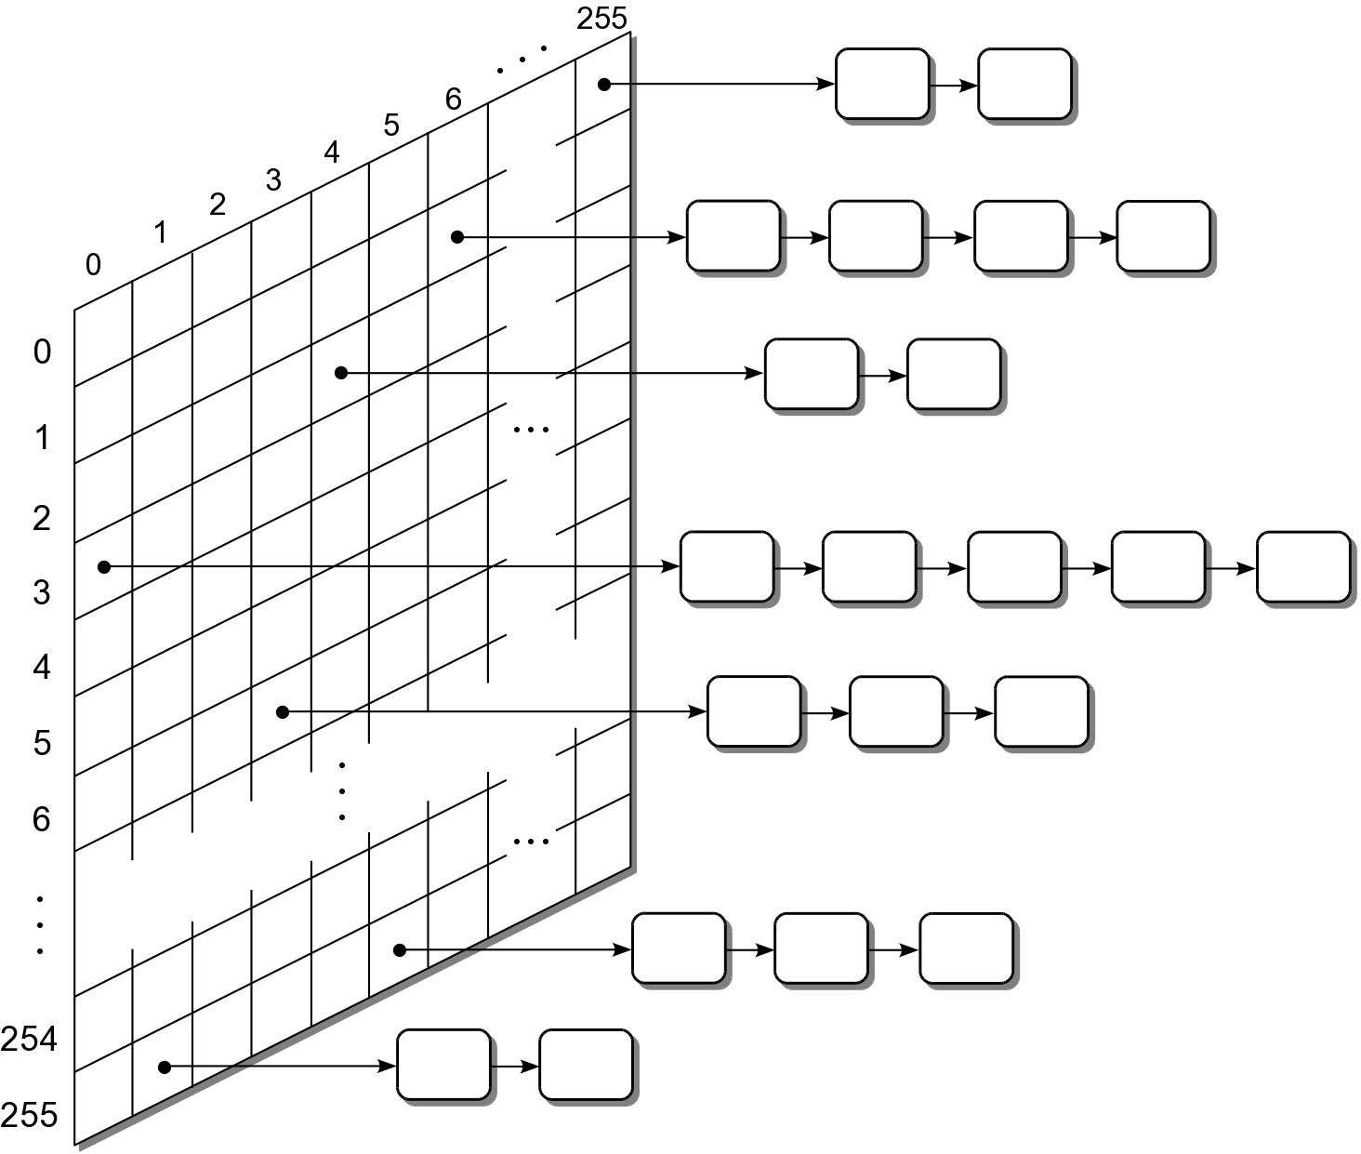
Color Histogram: Organization

Slide 54
Color Histogram: Traversals
After a color histogram is constructed, it's common to perform a traversal over the unique colors.
Could traverse over every element of the 2-D array.
Look for non empty chains and traverse the list.
This can be time consuming.
In practice, many of the elements will not contain any colors.
How can we improve the time required to perform a traversal.

Slide 55
Color Histogram: Traversals
Modify the structure:
add a second link to each color node to create multi-linked nodes.
when a new color is added to the histogram, add it to a second linked list (colorList).
A traversal is performed by iterating over the nodes in the colorList.

Slide 56
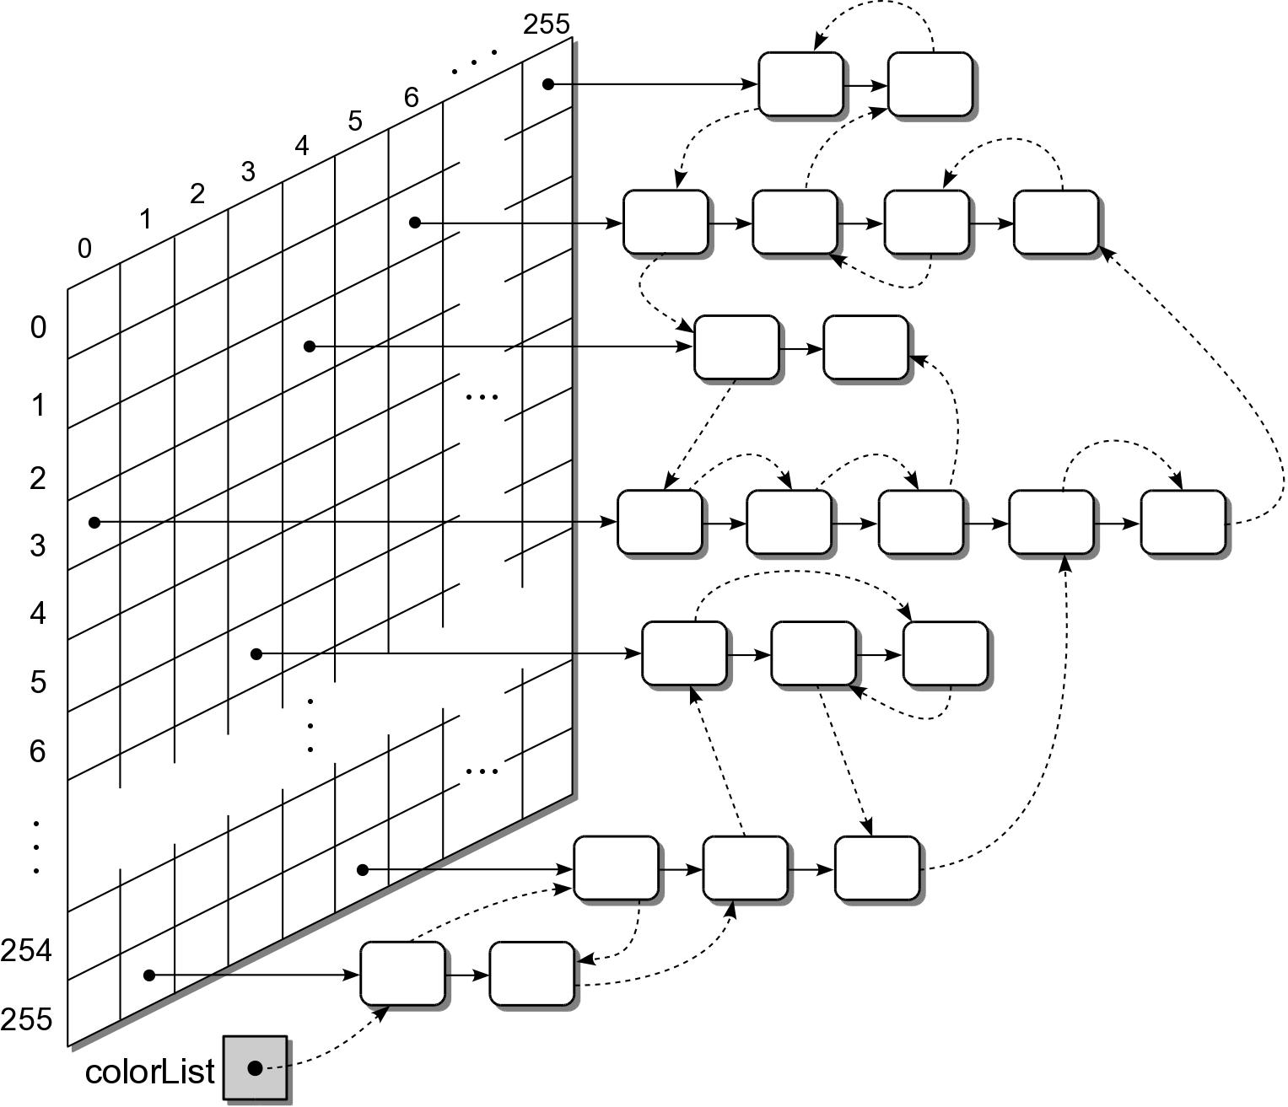
Color Histogram: Traversals

